Slide 1

Analysis of facebook data using R
Prasanna Kumar
Ramesh Chelliah
Sasidhran Thuthikulam Selvakumar
Tamilselvan Valathy Shanmugam

Slide 2

Why R Programming?
More handy for data manipulation e.g. Clustering and Classification.
Get better results faster
Rich in visualization libraries – pictures speak more than words!
Libraries are Open source

Slide 3
Limitations of R Programming…
Many R commands give little thought to memory management, and so R can very quickly consume all available memory
Execution speed is less and hence less efficient compared to other languages

Slide 4
Why should we care about social media?

Slide 5
Widespread use of social media sites
One in every ten people in the world logged onto Facebook.
71% of online adults in the US use Facebook
(84% use among ages 18–29)
600+ million tweets are sent everyday by
400+ million active users worldwide
23% of online adults in the US use Twitter
(31% use among ages 18–29)

Slide 6
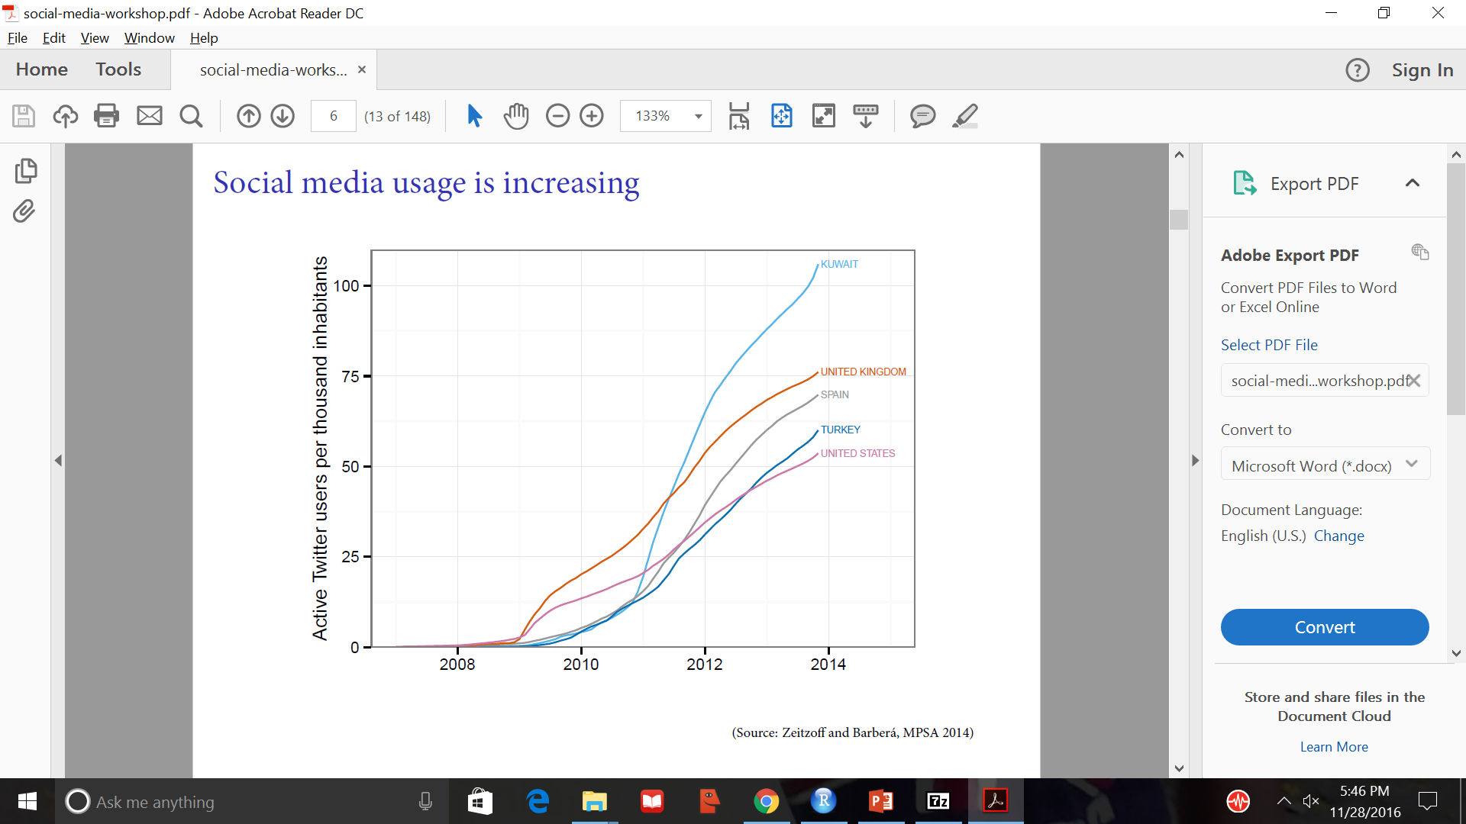
Social media usage is increasing

Slide 7
Packages Required
Rfacebook : This package is intended to provide access to the Facebook Graph API within R. It includes a series of functions that allow R users to extract their private information, search for public Facebook posts that mention specific keywords, capture data from Facebook pages, and update their Facebook status.
networkD3 : Tools for Creating D3 Network Graphs from R. This package is intended to create network graphs
plotrix : We used to draw pie charts in R.
ggplot2 : The ggplot2 package, created by Hadley Wickham, offers a powerful graphics language for creating elegant and complex plots.

Slide 8
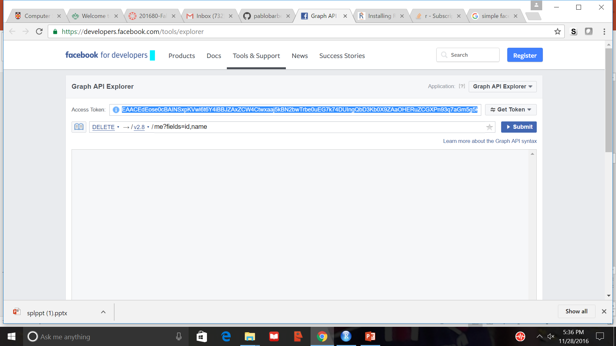
Data Extraction
Obtain a temporary access token from https://developers.facebook.com/tools/explorer
which can be used as argument in any of the functions in Rfacebook.
Web scraping.

Slide 9
Sentiment analysis
Sentiment, tone, valence, affective score... = % positive messages about a subject.
Methods of making analysis.
Dictionary method
Dictionary of positive and negative words (issue-specific)
Assigning score for positive and negative words

Slide 10
Machine learning
Training data: random sample of posts manually labelled as positive or negative
Classifier learns from data and predicts sentiment of unseen posts
Classifier used - Naïve Bayes
Accuracy score – 93%

Slide 11
Sentiment analysis of the political
Steps
Form the dictionary of positive and negative words.
Make a vector representation of the these words.
Train the model using the vector of words with the label.
Now, the classifier is ready to predict the incoming test data.
Do the classification for all the test data and visualize the output .

Slide 12
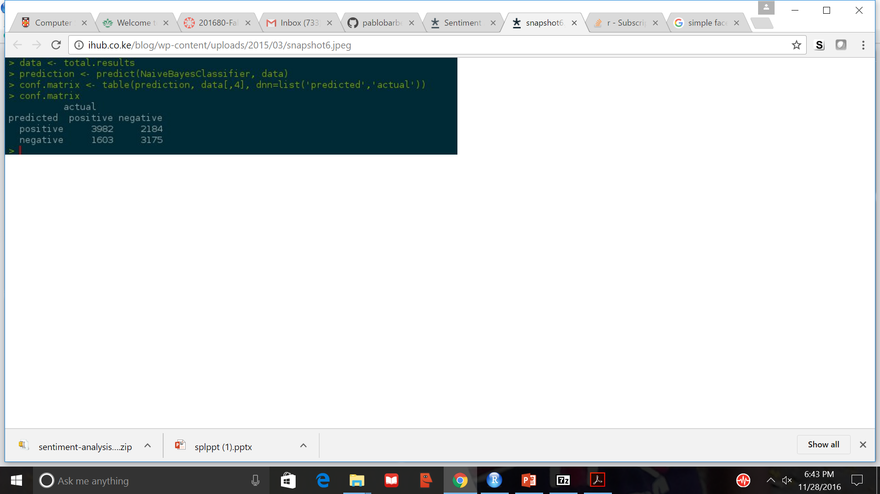
Sample confusion matrix output

Slide 13
Applications of this Sentiments
Using the Sentiment score, we can predict whether a post is positive or negative. So, during election times we can fairly predict the polls.
We can predict the mass protests in particular area of the country.

Slide 14
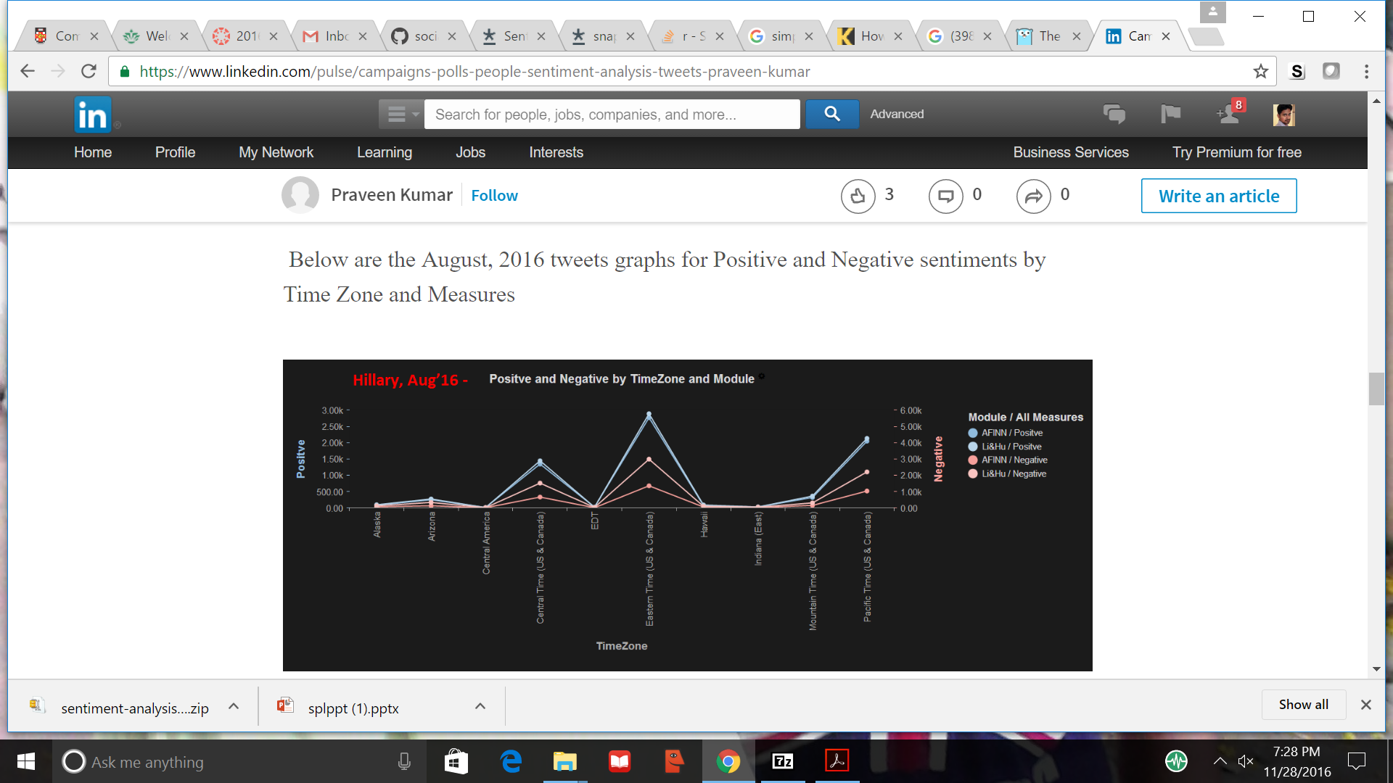
Sample outputs

Slide 15
What’s new and Innovative
Forming our own data set for the Positive and Negative emotional analysis.
Conducted experiments with different type of data and merged together to for GOLD DATA.
Experimenting with different classifiers for estimate better accuracy, precision and recall rates.
Mostly. Nowadays people tend to put more MEMEs, we even accommodated changes to recognize the positivity or negativity of the picture using Bag of visual words.

Slide 16
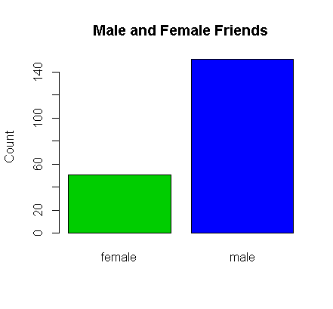
Analysis on Facebook Friends list
This plot shows number of male and female friends the user has. This is drawn using plot().

Slide 17
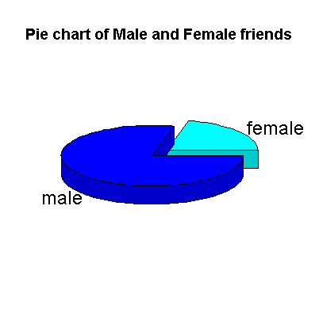
Analysis on Facebook Friends list
A 3D pie chart is another type of chart to show the male and female friends ratio, using “plotrix” package of R

Slide 18
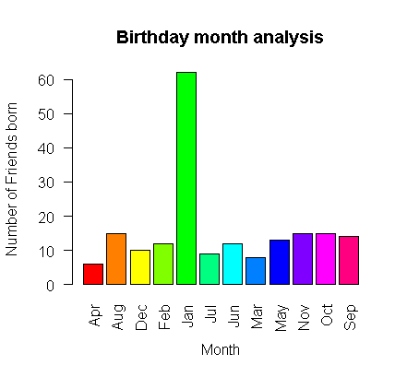
Analysis on Facebook Friends list
This plot shows friends who share their month of birthday

Slide 19
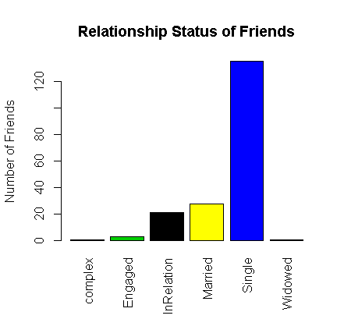
Analysis on Facebook Friends list
This plot shows count of friends according to their relationship status.
The bar charts are drawn using ‘plot’ in R.

Slide 20
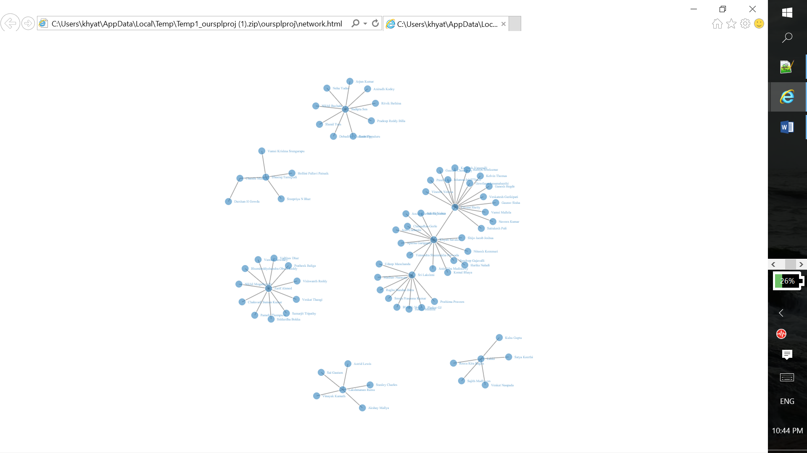
Networkgraph: The graph is an analysis of how the friends are connected among themselves. It’s shows cluster of mutual friends.
This graph is drawn using “simple network” of “networkD3” package in R.
file:///C:/R%20workspace/oursplproj/network.html

Slide 21
References
http://nlp.stanford.edu/~socherr/EMNLP2013_RNTN.pdf
https://cs224d.stanford.edu/reports/WangBo.pdf
https://www.cs.rochester.edu/u/qyou/papers/sentiment_analysis_final.pdf

Slide 22
Thank you

